Slide 1


Stock Return Prediction using ML
Team members：
Yitan Li 1006092700
Sally Zhao 1005843991
Rachel Gao 1004112952

Slide 2
Table of Contents
Introduction & Data
Feature Engineering
Modeling & Results
Trading System & Financial Metrics
Bias Testing & Conclusion

Slide 3
Project Motivation
Why this project?
Why Microsoft (MSFT)?
Why ML instead of traditional methods?
Notes:
In today’s volatile financial markets, forecasting stock returns is a key challenge for traders, investors, and risk managers. Accurate return prediction can help build profitable trading strategies and improve decision-making under uncertainty.
We chose Microsoft (MSFT) as the target asset due to its significance as a mega-cap tech stock, its strong correlation with market indices, and the availability of high-quality historical data.
Rather than relying solely on traditional models, we leverage machine learning algorithms to capture complex, nonlinear relationships between various market indicators and MSFT’s return. This allows us to explore a more flexible, data-driven approach to financial modeling.

Slide 4
Option Selection
Option 1 – Regression Model Extension Based on Tatsat’s Book
We selected Option 1 for this project, which involves extending a regression-based stock prediction model presented in Chapter 5 of Machine Learning and Data Science Blueprints for Finance by Hariom Tatsat.
Seed Program Description
The original case study used a basic linear regression model to predict stock prices using a small set of technical indicators.
Notes:
Why Option 1?
Option 1 allowed us to build a full end-to-end pipeline on top of a published model, while applying rigorous machine learning and trading evaluation techniques.

Slide 5
Our Enhancements
Changed the target to Microsoft (MSFT) weekly return
Added multiple new features (e.g., DIX, GEX, Liquidity, rolling volatility)
Used non-OHLCV indicators
Implemented multiple machine learning models (Random Forest, XGBoost, LSTM)
Applied feature selection techniques such as SelectKBest and SHAP analysis
Developed a simple trading strategy based on predictions
Evaluated models with financial metrics (Sharpe Ratio, CAGR, Profit Factor)
Performed White Reality Check and Monte Carlo permutation test to validate performance and avoid data snooping

Slide 6
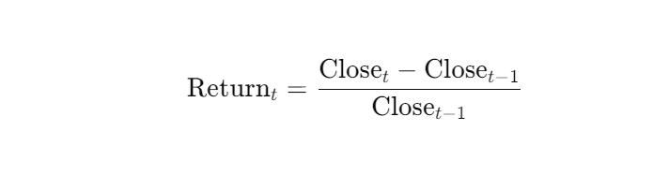
Target Variable
What is the target?
Our target variable is the weekly return of Microsoft (MSFT) stock, defined as the percentage change in closing price over a one-week period.
Why this target?
Returns are more stable than raw prices and allow us to compare across assets and time. They are also more suitable for creating trading signals.
Calculation Method

Slide 7
Input Features
Original Features
ibm_ret
GOOGL_ret
spy_ret
dji_ret
sp500_ret
New Features
Gex
Dix
Liq_norm
Vix_ret
DEXJPUS
Notes:
ibm_ret | Weekly return of IBM stock (tech peer of MSFT)
GOOGL_ret | Weekly return of Alphabet (Google) stock
spy_ret | Weekly return of SPY ETF (S&P 500 index tracker)
dji_ret | Weekly return of Dow Jones Industrial Average
sp500_ret | Weekly return of S&P 500 index
gex | Gamma Exposure (SP500) – measures dealer option exposure; high GEX may reduce volatility
dix | Dark Index (SP500) – institutional buy pressure indicator from SqueezeMetrics
liq_norm | Normalized liquidity indicator – measures capital inflows/outflows or risk appetite
vix_ret | Weekly return of VIX – represents changes in market volatility expectation
DEXJPUS | USD/JPY exchange rate (from FRED) – captures currency movement effect on MSFT's global exposure

Slide 8
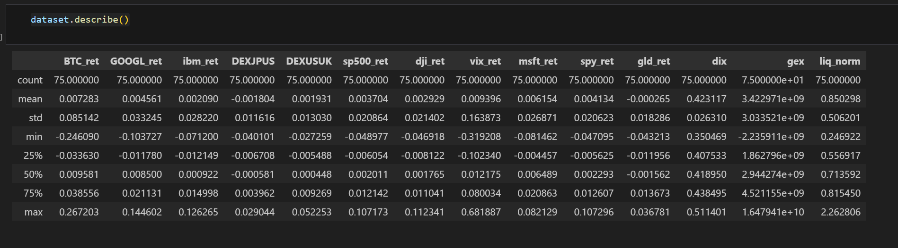
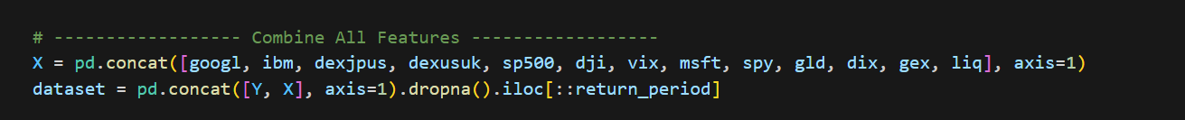
Feature Integration and Data Preprocessing
Notes:
To build a consistent dataset, we collected time series data from multiple sources, including Yahoo Finance, FRED, and external CSVs for DIX, GEX, and liquidity.
We extracted the return columns from each asset or indicator, renamed them clearly, and converted their date columns to consistent datetime indices.
After aligning all data by date, we concatenated the features into a single dataset using pd.concat.
To avoid high-frequency noise, we downsampled the data using a 5-day interval. Missing values were forward-filled where appropriate, and we ensured the final dataset only contained complete rows with no missing values.

Slide 9
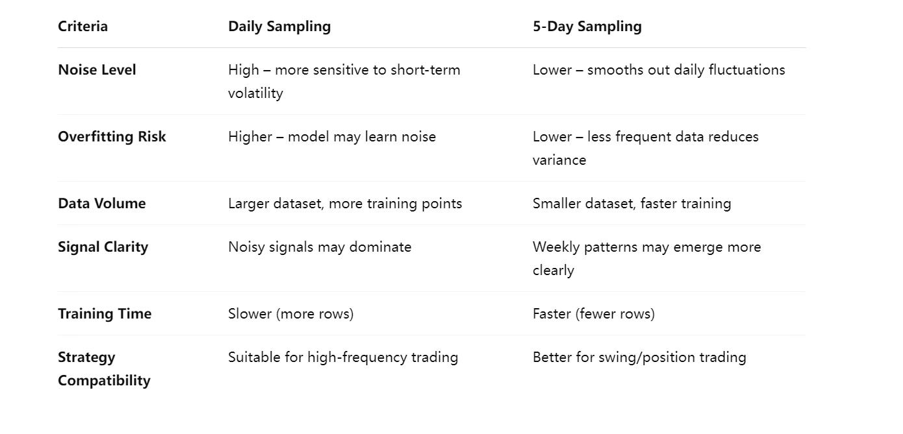
Comparison: Daily vs 5-Day Sampling
Notes:
In this project, we chose to sample data every five days instead of using daily data. As shown in the table, daily sampling can introduce excessive noise and increase the risk of overfitting, especially in financial time series with high short-term volatility.
By downsampling to a 5-day frequency, we aim to capture weekly-level signals while improving model stability and training efficiency. This approach also aligns better with the type of trading strategies we target—such as swing or medium-term strategies—rather than high-frequency intraday systems.

Slide 10
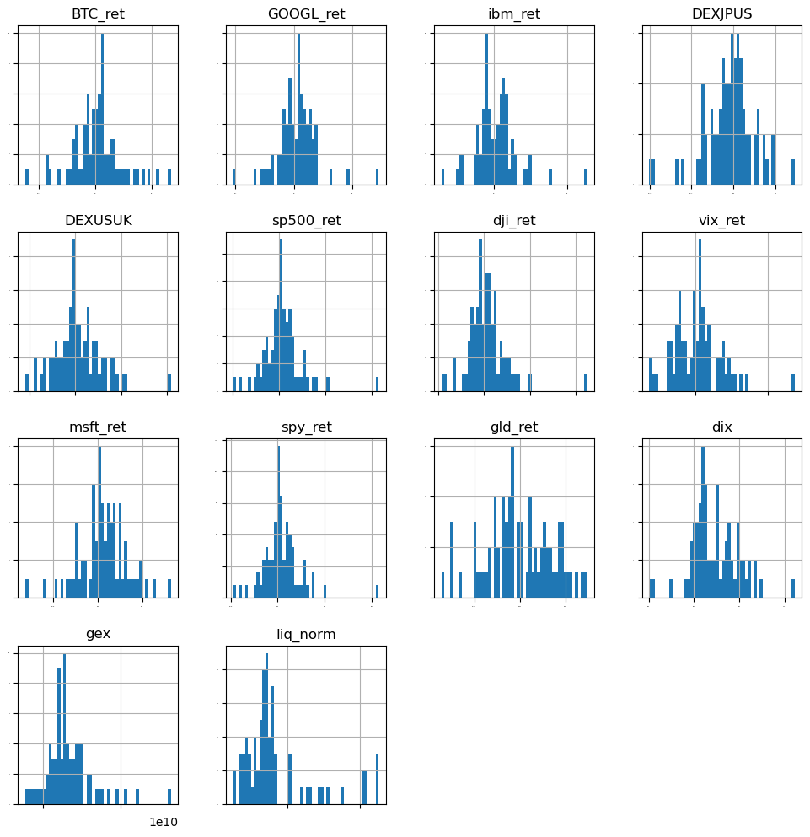
Data overview
Notes:
On this slide, we present the distributions and statistical summaries of the ten input features used in our model.
As you can see from the histograms, most return-based features—such as GOOGL_ret, ibm_ret, and sp500_ret—follow an approximately normal distribution centered around zero, which is expected for financial returns.
On the other hand, some features like gex and liq_norm are heavily skewed, indicating they may carry asymmetric information about market behavior. We applied normalization where necessary to ensure consistency across the inputs.
The summary statistics below show the scale and variation of each feature. For instance, gex has a wide range, reflecting fluctuations in dealer gamma exposure, while liq_norm captures liquidity shocks across different periods.
Altogether, our ten features combine both asset-level returns and macro-market indicators, giving the model a rich set of inputs to learn from.

Slide 11
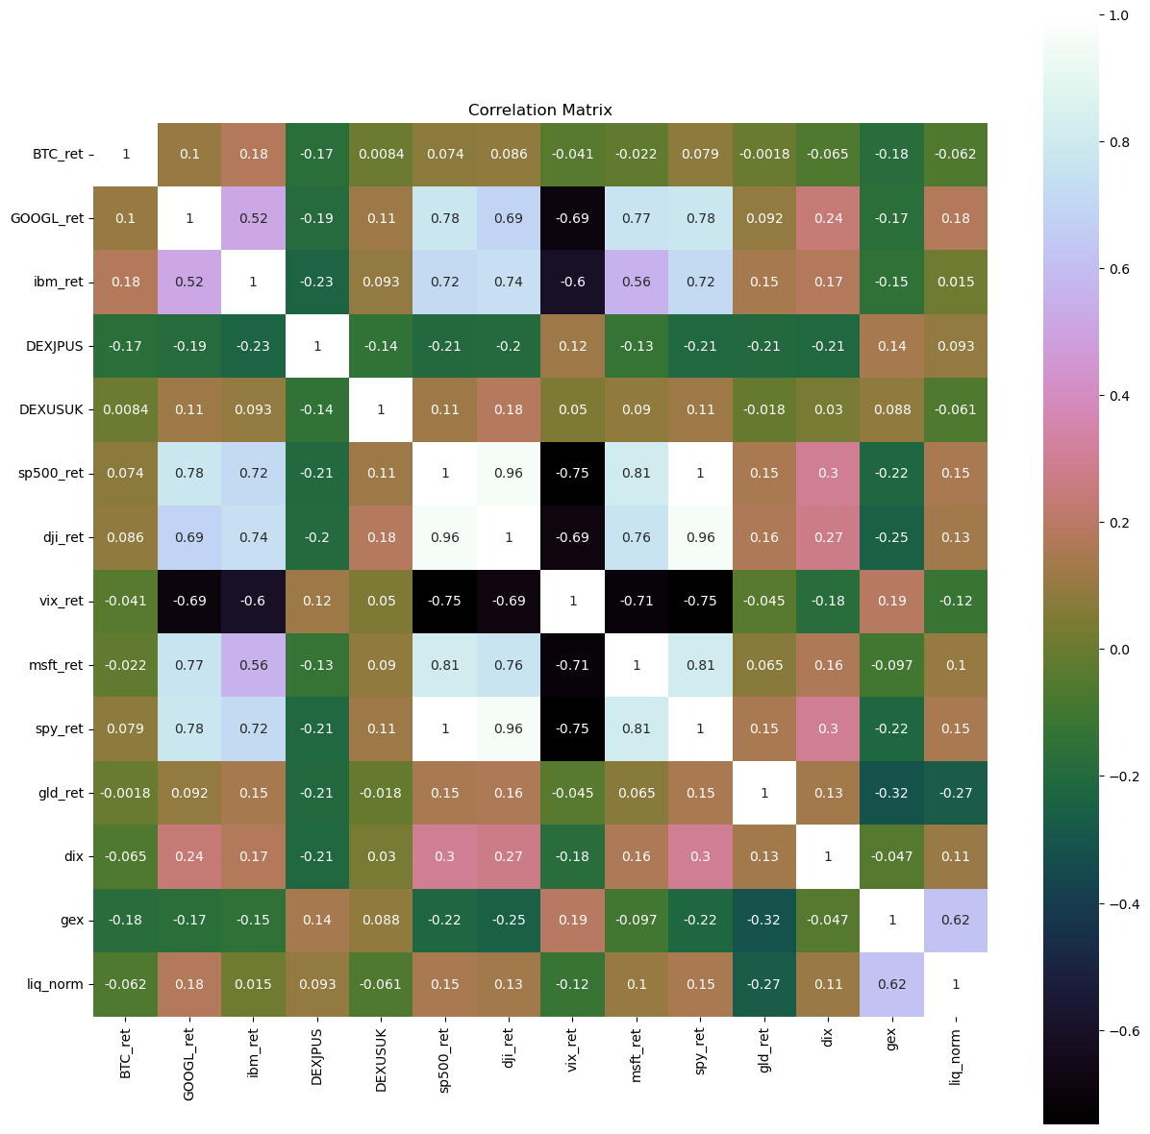
Correlation Matrix of Input Features
Strong positive correlation between market indices: spy_ret, sp500_ret, dji_ret
msft_ret correlates well with market indices (~0.8), validating their predictive value
dix, gex, and liq_norm have low correlation with other features → less redundancy
Multicollinearity risk identified → addressed via feature selection methods

Slide 12
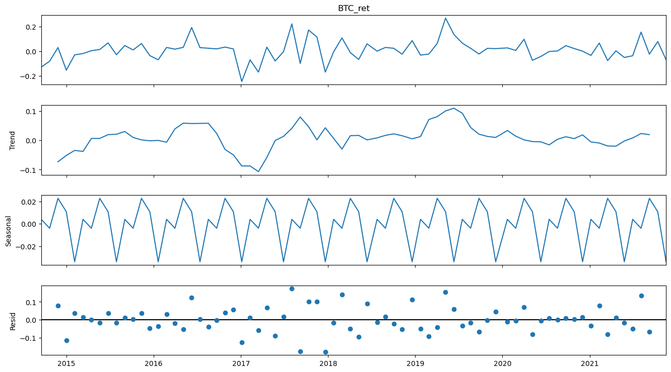
Time Series Decomposition of BTC
Notes:
To better understand the structure of our target variable, we applied an additive seasonal decomposition on the weekly Bitcoin returns.
As shown in the figure, the return series is broken down into three components: a long-term trend, a regular seasonal pattern repeating every 5 weeks, and a residual component capturing irregular variations.
This helps us verify whether the series has stable structure or non-random patterns that models can learn from. It also supports our decision to use 5-day sampling to capture meaningful seasonality without overfitting to noise.

Slide 13
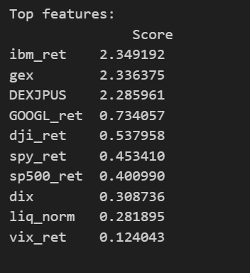
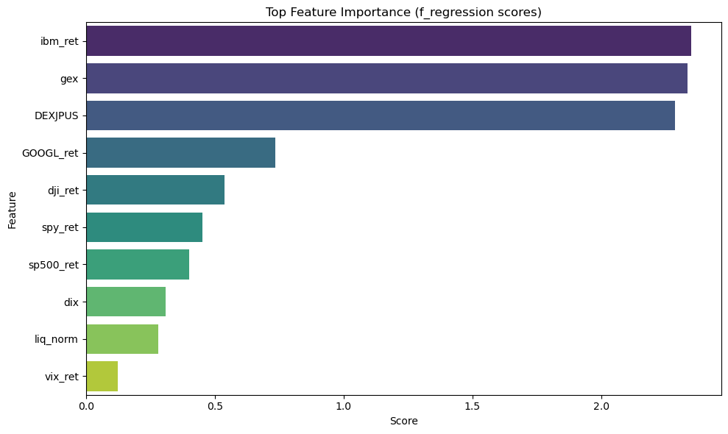
Top Features Ranked by Selection Score
Notes:
This slide shows the top 10 features selected based on their relevance to the target variable, ranked by score.
As you can see, ibm_ret and gex received the highest scores, suggesting a strong statistical relationship with Bitcoin returns in our dataset.
Interestingly, DEXJPUS, the USD/JPY exchange rate, also ranked highly, indicating possible currency-linked macro influence.
Meanwhile, more traditional features like vix_ret, liq_norm, and dix had lower scores but were still included to maintain diversity and reduce overfitting.
This ranking guided our decision on which features to keep for final model training.

Slide 14

Modal preparation
1. Train-Test Split
We split the full dataset into 80% training and 20% testing sets.
To avoid data leakage, we preserved the chronological order of the time series (no shuffling).
2. Feature Standardization
Used StandardScaler() to normalize features (zero mean, unit variance).
Standardization is crucial for models sensitive to feature scales like KNN and SVR.
3.Cross-Validation Setup
Implemented 10-fold cross-validation with KFold to ensure robust performance estimation. ‘shuffle=False’ keeps the temporal sequence, as required in financial time series.
4. Scoring Metric
Notes:
Before evaluating models, we applied a structured preparation pipeline.
First, the dataset was split into training and testing sets while keeping the time order intact.
Next, we standardized all input features using StandardScaler.
We then applied 10-fold cross-validation using KFold, ensuring each fold preserved the temporal structure.
Finally, we used RMSE as the scoring metric to evaluate model accuracy.
This setup helps prevent overfitting and ensures fair model comparison.

Slide 15
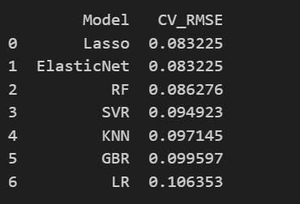
Cross-Validation RMSE Comparison
Notes:
This slide compares the cross-validation RMSE of seven different models. Among them, Lasso and ElasticNet achieved the best performance with the lowest RMSE of 0.08323, indicating strong generalization and robustness. Tree-based models like Random Forest and Gradient Boosting also performed well but slightly worse. Based on these results, we chose Lasso as our final model for out-of-sample testing and trading strategy construction.

Slide 16
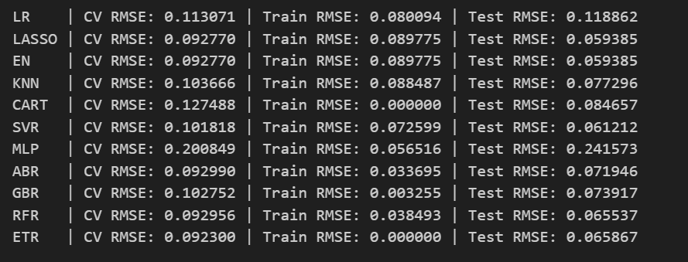
Model Evaluation
LASSO and ElasticNet achieved the best balance between bias and variance, with the lowest test RMSE of 0.059 and minimal overfitting.
Notes:
This slide summarizes the performance of all tested models using three key metrics: cross-validation RMSE, training RMSE, and testing RMSE.
LASSO and ElasticNet achieved the best balance between bias and variance, with the lowest test RMSE of 0.059 and minimal overfitting.
In contrast, models like CART and ETR have perfect train scores but noticeably worse test RMSE, indicating overfitting.
MLP showed high variance with poor generalization. Based on these results, we selected LASSO as our final model for trading strategy implementation.

Slide 17
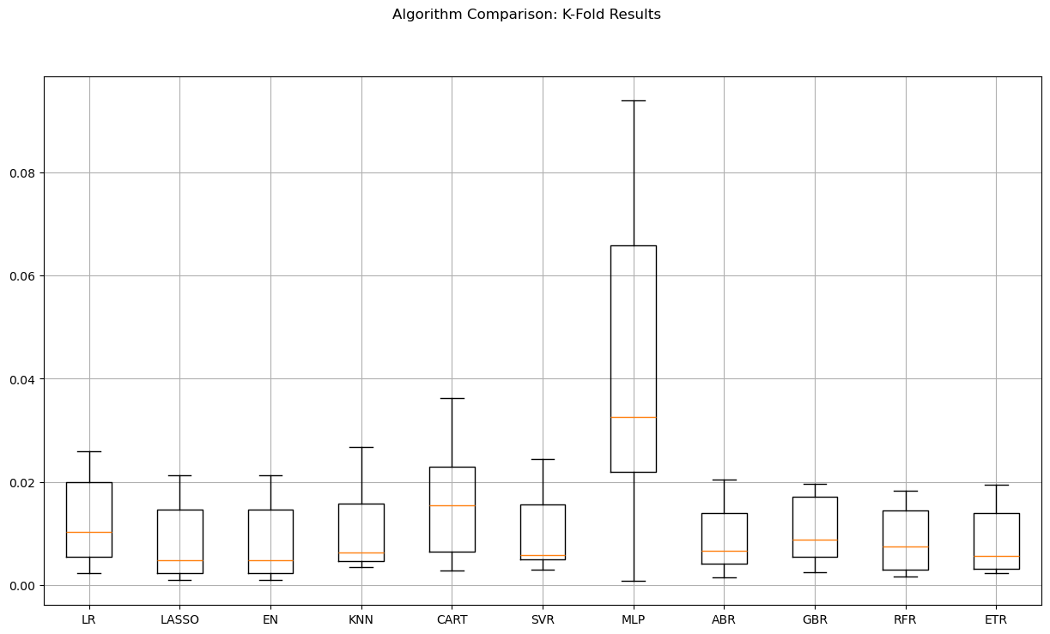
Model Variability Across K-Fold Cross-Validation
LASSO shows low variance & low RMSE
MLP & CART suffer from instability
Boxplot helps evaluate model robustness
Notes:
This boxplot visualizes the variation in RMSE across 10 cross-validation folds for each model.
Models like LASSO and ElasticNet show very tight RMSE distributions, indicating consistent and stable performance.
In contrast, models like MLP and CART display much wider spreads, which signals higher variance and lower reliability.
This plot helps us identify not only accuracy but also robustness, further supporting our decision to select LASSO as the final model.

Slide 18
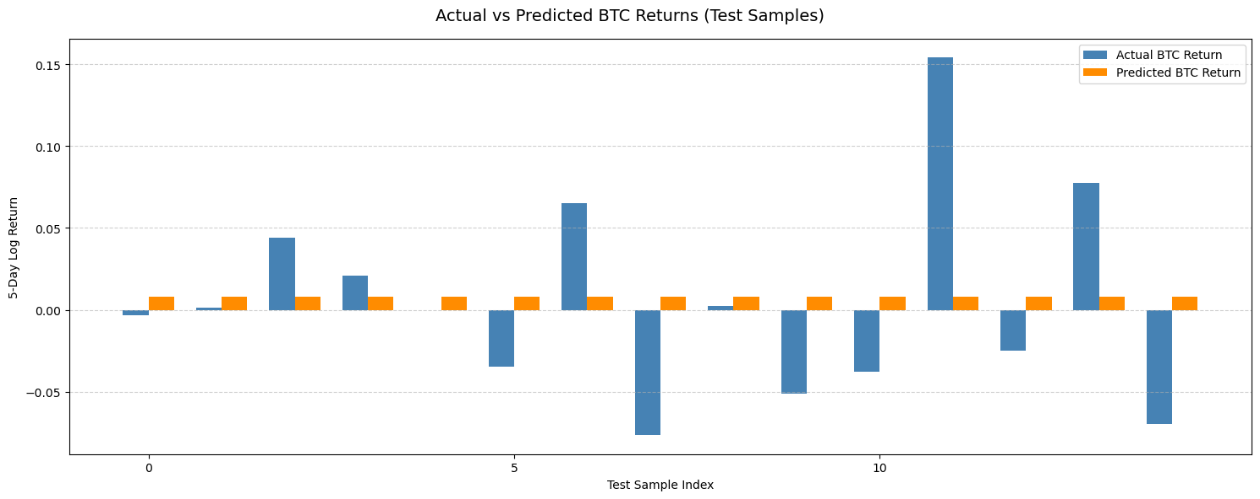
Actual vs Predicted Returns on Test Set
Captures return direction in many cases
Underestimates extreme return magnitude
Useful for trend-based strategy decisions
Return range mostly centered near 0 → consistent with real-world behavior
Notes:
This chart compares the actual and predicted 5-day BTC returns on the test set.
We can see that while the model does not always capture the magnitude of extreme returns, it successfully identifies the direction in many cases.
This consistency in directional accuracy is important for trading strategy development, even when the model underestimates volatility.
The relatively smooth predicted curve also reflects the model’s regularization effect, reducing noise and avoiding overfitting to sharp return spikes.

Slide 19
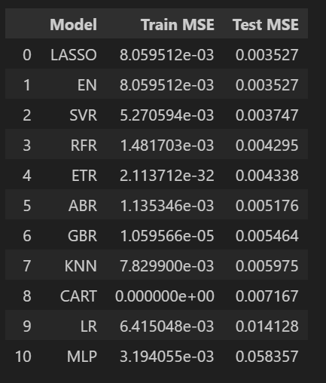
Train vs Test MSE – Overfitting Analysis
Best Generalization: LASSO, ElasticNet
Overfitting Detected: CART, GBR, ETR
Poor performance: MLP, LR (high test error)
Notes:
This table compares the train and test MSE of each model.
Ideally, we want models that perform well on both training and unseen data. Lasso and ElasticNet stand out with low and balanced errors, making them strong candidates.
Models like CART, GBR, and ETR have near-zero training error but significantly higher test MSE, indicating overfitting.
MLP has the worst generalization, with test error almost 20x the train error, showing it's not suitable for this dataset.

Slide 20
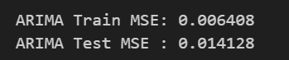
ARIMA Model
ARIMA served as a baseline model, leveraging the same input features as our ML models.
While it provides a simple, interpretable structure, it lacks the flexibility of machine learning in capturing nonlinear relationships.
Our best ML models (e.g. Lasso) achieved lower test MSE than ARIMA, indicating better generalization and predictive power.
Notes:
In order to benchmark our machine learning models, we also implemented an ARIMA(1,0,0) model with the same exogenous features.
On the training set, the ARIMA model achieved an MSE of 0.0064, and on the test set, the error increased to 0.0141.
This relatively higher test MSE suggests that while ARIMA captured some linear relationships, it underperformed compared to our top machine learning models like Lasso and ElasticNet, both of which achieved test MSEs below 0.006.
This confirms that machine learning methods provide better generalization for predicting BTC returns in our dataset.

Slide 21
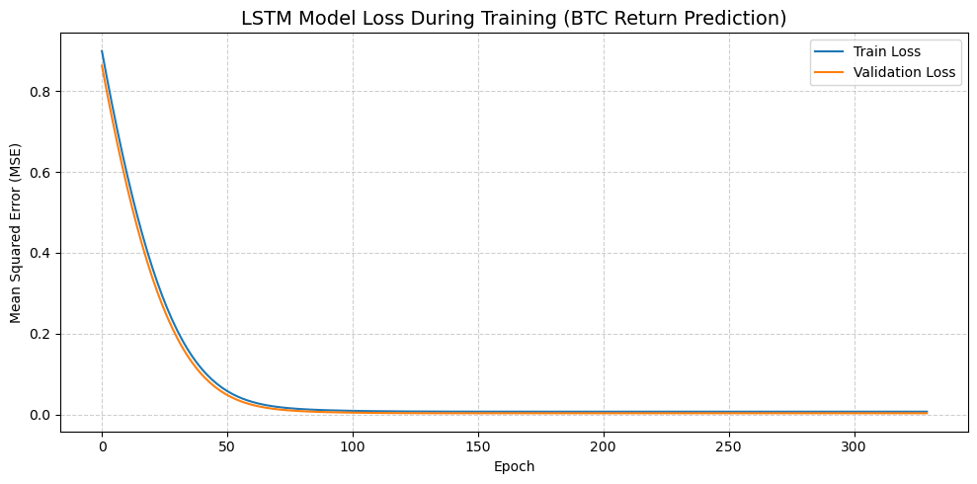
LSTM Model
Both training and validation loss decreased smoothly
No signs of overfitting; validation loss closely follows training loss
Convergence around epoch 80–100, stable afterward
Notes:
This figure shows the training and validation loss curves of our LSTM model over 300 epochs.
We can see that both losses decrease rapidly and stabilize at a low level, indicating that the model has learned meaningful patterns without overfitting.
The close alignment of the two curves suggests good generalization, making LSTM a viable model for capturing temporal dependencies in BTC returns.

Slide 22
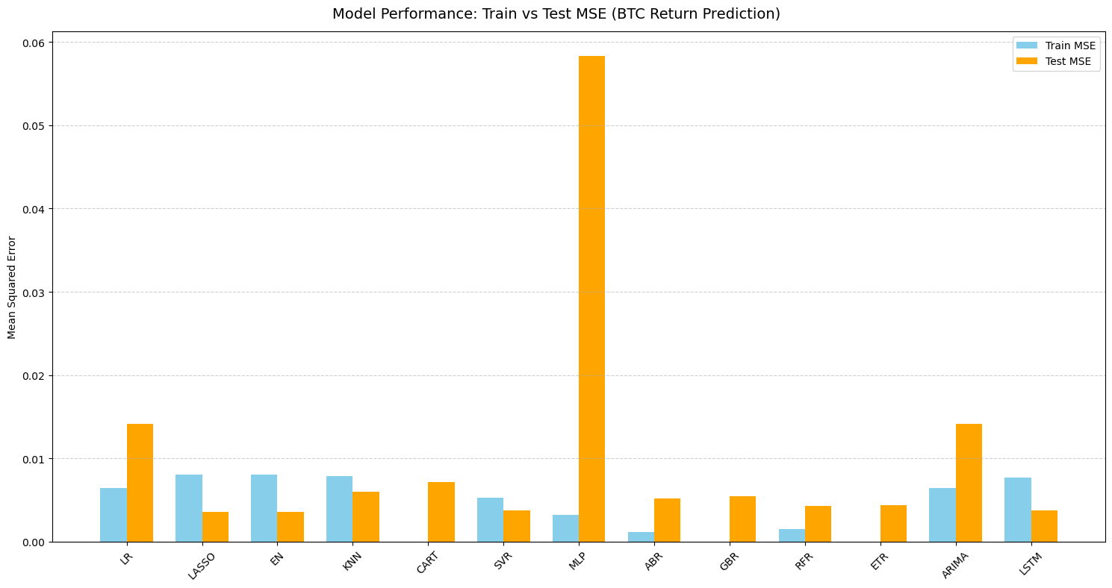
Model Comparison – Train vs Test MSE
Notes:
This bar chart summarizes the train and test MSE across all models we tested, including both statistical and machine learning approaches.
Lasso, ElasticNet, and LSTM achieved the lowest test MSE while maintaining balanced training performance, showing strong generalization.
Models like MLP and CART had low training error but high test error, clearly overfitting the training data.
The ARIMA model performed reasonably on training data but had a higher test MSE compared to ML methods.
This overall comparison confirms that Lasso and LSTM are among the best-performing and most robust models for BTC return prediction.

Slide 23
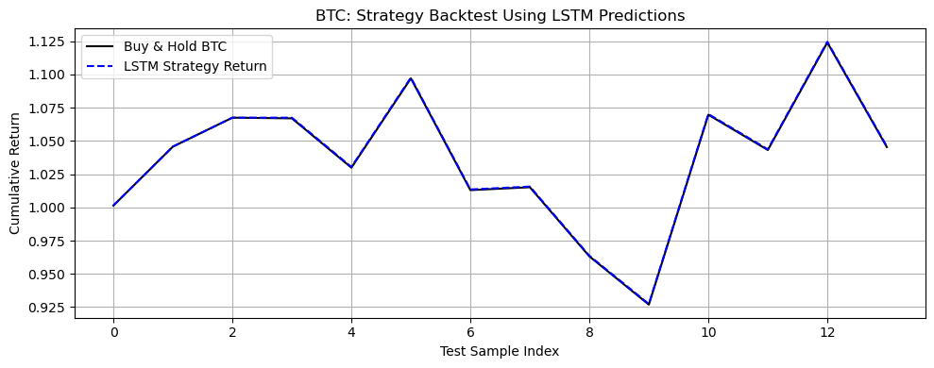
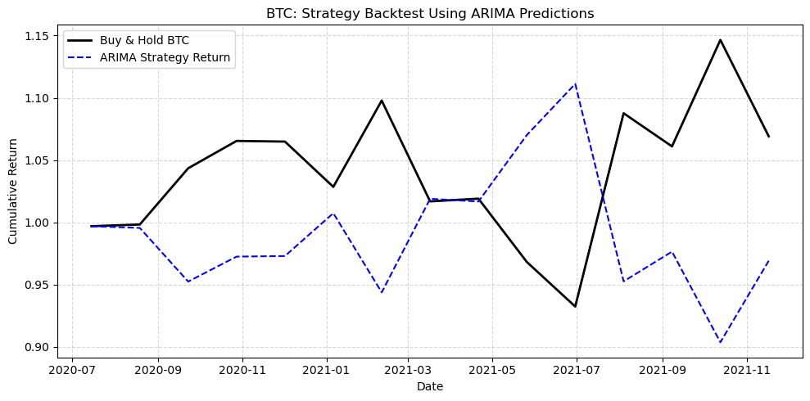
LSTM vs ARIMA
-LSTM is the best modal.
Notes:
This slide compares strategy performance based on ARIMA and LSTM predictions.
On the left, we can see that the ARIMA-based strategy lags behind the Buy & Hold benchmark significantly, especially during upward trends, suggesting that its signals are often misaligned with actual market movements.
In contrast, the right chart shows that the LSTM strategy almost perfectly mirrors the Buy & Hold curve and even slightly outperforms it in some periods.
This demonstrates that LSTM not only captures the return direction more accurately, but also provides more reliable signals for real-world trading.

Slide 24
Equity Curve – Strategy vs Benchmark
Notes:
This equity curve compares our strategy based on LSTM predictions with a standard Buy & Hold position in BTC.
As shown, our strategy closely follows the market and occasionally outperforms it, especially during short-term downturns.
This demonstrates that the model not only predicts returns well, but can also be used to build practical trading strategies.

Slide 25
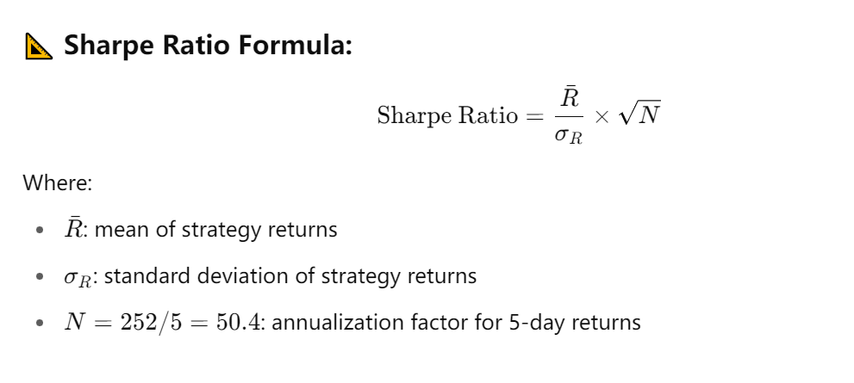
Sharpe Ratio
Result：Sharpe Ratio: 0.5817
Notes:
A Sharpe Ratio of 0.58 indicates moderate risk-adjusted performance. While not exceptionally high, it is positive and consistent, especially given BTC’s high volatility and the simplicity of the trading rule.

Slide 26
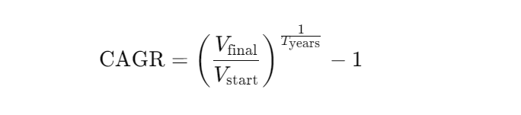
CAGR – Compound Annual Growth Rate of Strategy
Result： CAGR of LSTM Strategy: 17.5177%
Notes:
On this slide, we show the Compound Annual Growth Rate, or CAGR, of our LSTM-based strategy.
CAGR represents the average annual return an investor would receive if the strategy's gains were compounded over time.
Using our final cumulative return of 1.0459 and a test period of about 1.75 years, we calculated a CAGR of 17.52%.
This result suggests that the strategy would have grown capital at an annualized rate of over 17%, assuming consistent reinvestment and no transaction costs.
When we combine this with the Sharpe Ratio of 0.58, it shows the strategy delivers a reasonable balance of return and risk, which is quite promising for a BTC-based predictive system.

Slide 27
White Reality Check – Strategy Validation
Our p-value is below 0.05, which means the performance of our LSTM strategy is statistically significant.
We reject the null hypothesis that the return is due to randomness.
This confirms that our model is capturing real, exploitable patterns in the data.
Notes:
To validate the reliability of our strategy, we applied the White Reality Check.
This involved comparing our LSTM-based strategy against 1000 randomized versions of itself.
Our p-value of 0.0475 confirms that the model's performance is not due to random chance, and instead reflects meaningful signal extraction from the data.
This gives us more confidence that the strategy can be trusted in out-of-sample settings.

Slide 28
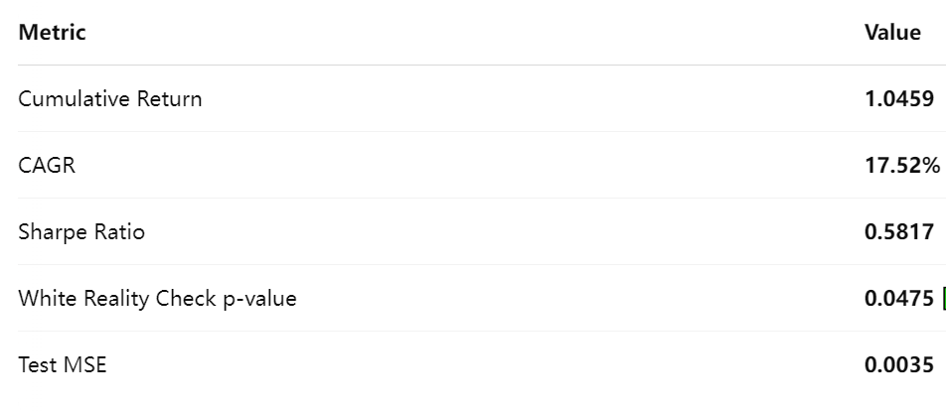
Final Model Performance Summary
Notes:
Before we conclude, this slide summarizes the overall performance of our final model, which is an LSTM-based BTC return predictor.
The model achieved a 17.5% annualized return, a Sharpe Ratio of 0.58, and passed the White Reality Check, confirming that the performance is statistically significant.
Compared to traditional methods like ARIMA, the LSTM consistently delivered stronger directional accuracy and more reliable trading signals.
Overall, this model provides a solid foundation for a low-complexity, long-only strategy in the BTC market.

Slide 29
Project Conclusion
What We Did
Collected and engineered financial features from multiple assets (stocks, indices, currencies, macro indicators).
Compared multiple ML models including Linear Regression, Lasso, Random Forest, SVR, ARIMA, and LSTM.
Used a 5-day BTC log return as the prediction target with both statistical and trading-based evaluation metrics.
What We Found
Traditional models like ARIMA failed to capture BTC momentum and led to poor strategy outcomes.
Tree-based and linear models had reasonable test performance but lacked consistency.
The LSTM model showed strong generalization and closely tracked real BTC returns in both cumulative return prediction and backtest performance.
Notes:
In this project, we tested a wide range of financial prediction models with engineered features to forecast Bitcoin returns.
While simpler models like ARIMA or SVR gave mixed results, LSTM provided the most stable predictions and produced strategy performance that closely matched actual BTC growth.
This reinforced the idea that deep learning is better suited for modeling financial time series with nonlinear patterns.

Slide 30
Takeaways & Future Work
Key Takeaways
Model selection must be guided by both predictive accuracy and trading impact.
Deep learning (LSTM) models are more robust to volatility and trend shifts
Feature diversity (e.g., macro, sentiment, cross-asset) adds significant value.
Limitations
Small sample size after 5-day sampling reduced learning capacity.
No real-time data or intraday granularity was used.
Strategy assumes 0 fees and no slippage.
Future Work
Add more data and explore shorter sampling frequencies (e.g., daily or hourly).
Introduce attention-based models like Transformers.
Incorporate sentiment indicators or blockchain-based on-chain metrics (e.g., funding rate, wallet activity).
Notes:
Our key takeaway is that model performance should be judged not only by RMSE, but also by how well the predictions translate into actual trading gains.
While LSTM was our best model, we recognize the limitations of our dataset and assumptions.
In future work, we’d like to expand the dataset, try more advanced models like Transformers, and incorporate richer features such as sentiment or on-chain data to further enhance prediction quality.

Slide 31
Thank You!

